Slide 1
Archaeological_Sitesclassification
Team 6

Slide 2
Team 6 members
1 - Ibrahim AL-jarrah 2- Ruba Ababneh 3- Mohammed AL-karmy 4- Saja AL-zoubi

Slide 3
TABLE OF CONTENTS
01
02
03
04
05
06
Introduction
Problem Statement
Data collection & Preprocessing
Conclusion & future work
Modelling
Result
07
Demo

Slide 4
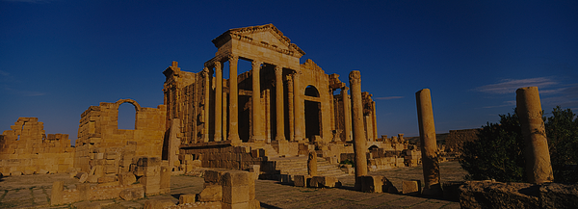
01
Introduction

Slide 5
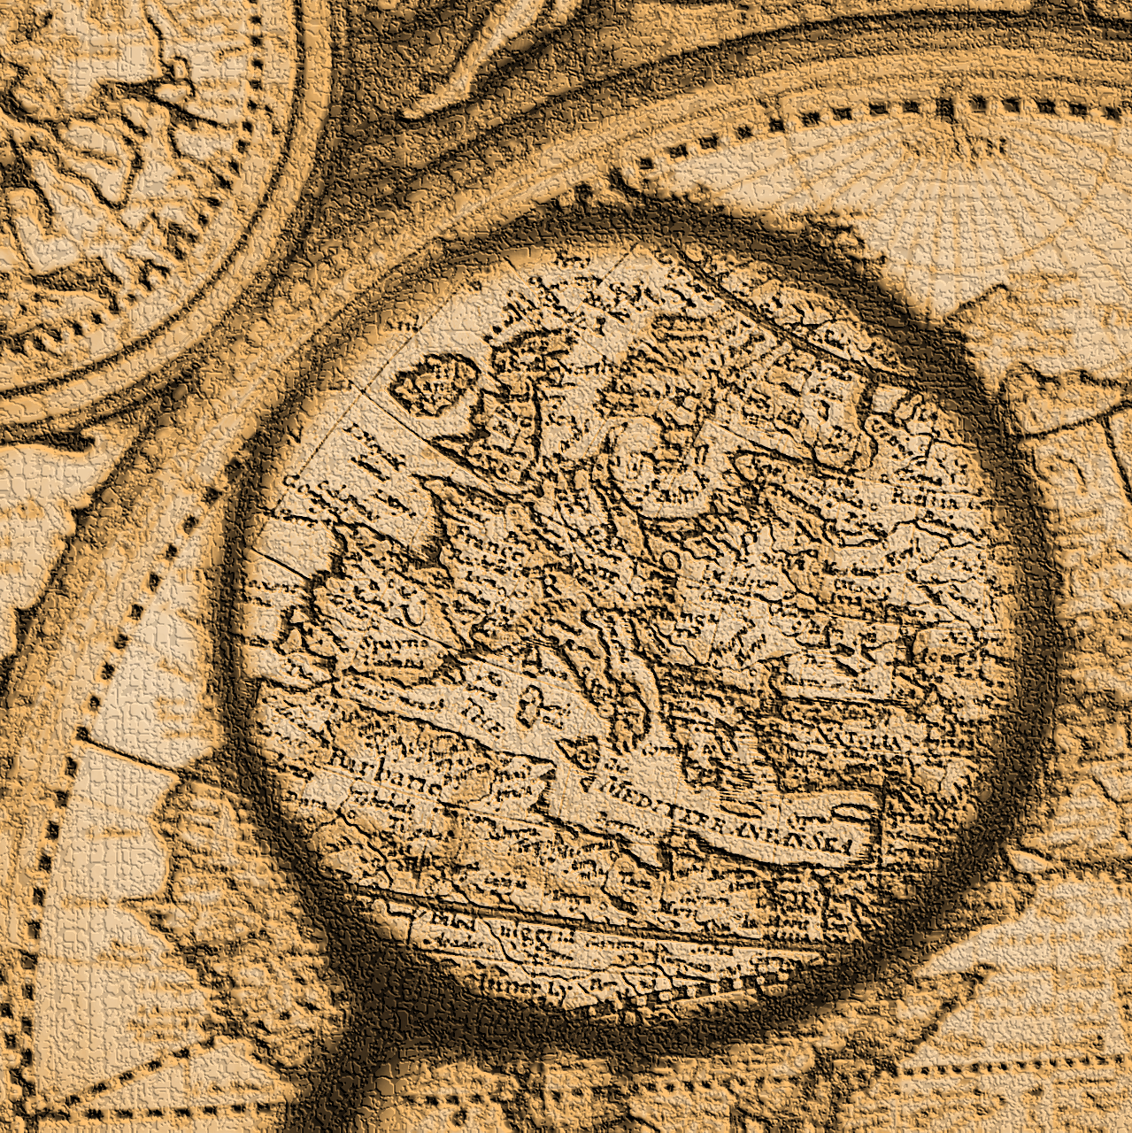
Introduction
In the field of archaeology, the integration of advanced technologies has become paramount for enhancing research methodologies. One such innovative approach involves the application of deep learning models for the automated classification of archaeological sites through image analysis. This project seeks to leverage the power of pre-trained models to achieve both accuracy and efficiency in the identification and classification of certain archaeological sites.

Slide 6
02
Problem
Statement

Slide 7
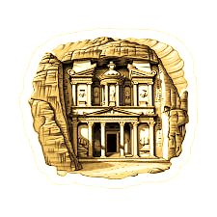
Problem Statement
Classification of archaeological sites faces the challenge of efficiently classifying and identifying diverse archaeological sites. Traditional methods are often time consuming and may lack the accuracy required for correct classification. To address this problem, our project focuses on developing a deep learning model that uses pre-trained models for automated image classification of archaeological sites. By doing so, we aim to enhance the accuracy and speed of location identification, providing tourists for example with a valuable tool to simplify their research processes.

Slide 8
03
Data collection & Preprocessing

Slide 9

Data collection & Preprocessing
Um Qais 810
Jerash 703
Petra 607
Ajloun Castle 572
Wadi Rum 614
Roman
Amphitheater 520

Slide 10

Data collection & Preprocessing
Normalization
dividing by 255
One-Hotencoding
LabelBinarizer
Ajloun: [1 0 0 0 0 0]
Petra : [0 1 0 0 0 0]
Roman_Theater: [0 0 1 0 0 0]
Jerash : [0 0 0 0 1 0]
Wadi_Rum : [0 0 0 1 0 0]
Um_qais : [0 0 0 0 0 1]

Slide 11
04
Modeling

Slide 12
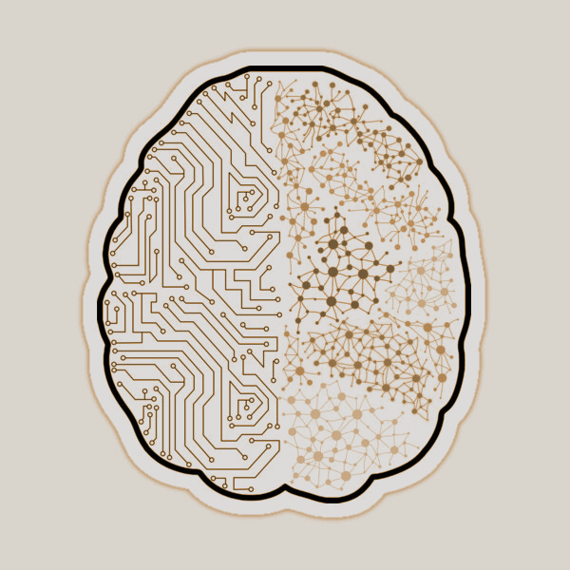
Without pretrained models
with augmentation
Without pretrained models without augmentation
With pretrained models & with augmentation
With pretrained models & without augmentation

Slide 13
Models Parameters
Activation For Output
Softmax
Shape of X_train: (3060, 256, 256, 3)
Shape of X_test: (766, 256, 256, 3)
Shape of y_train: (3060, 6)
Shape of y_test: (766, 6)
Target size
256,256
Test size
0.2
EPOCHS
30
loss
categorical_crossentropy
adam
optimizer

Slide 14
4.1
CNN model

Slide 15
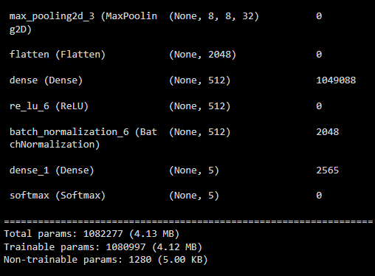
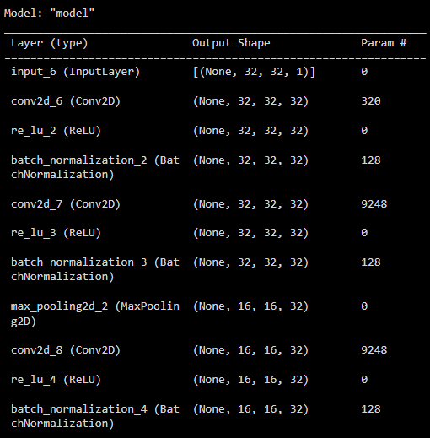
Without pretrained models - Model Architecture

Slide 16
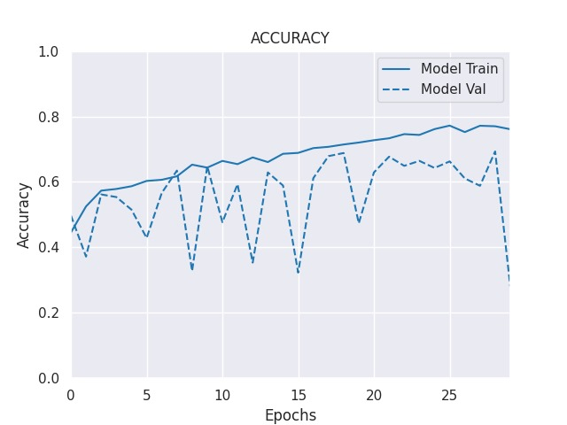
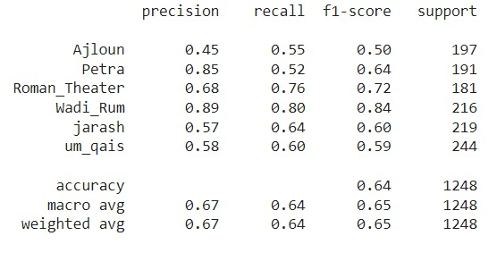
01
CNN model with augmentation

Slide 17
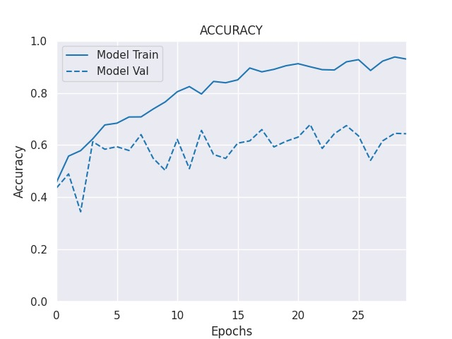
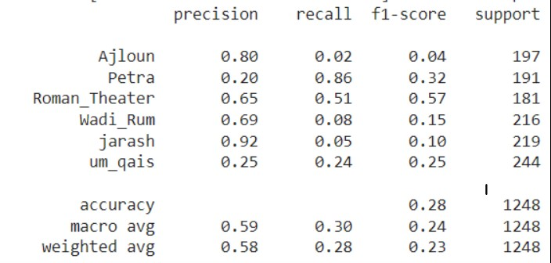
02
CNN model without augmentation

Slide 18
4.2
Pretrained
models

Slide 19
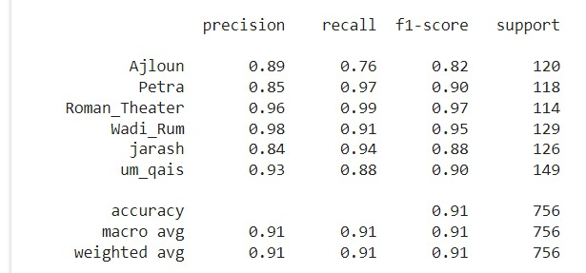

01
pretrained models without augmentation
VGG16

Slide 20
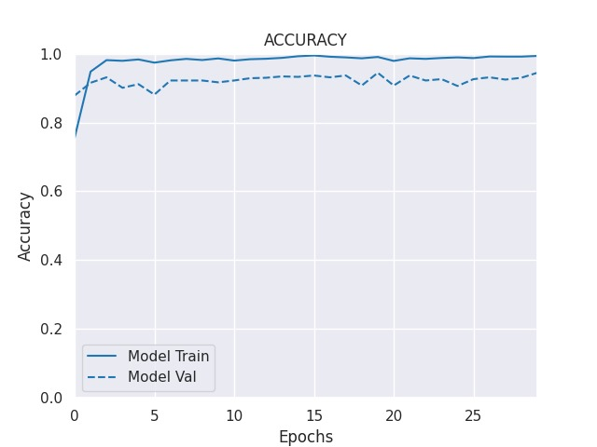
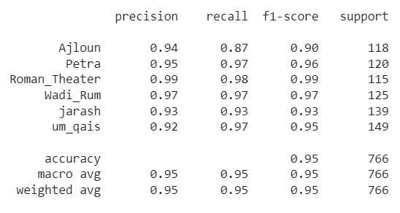
InceptionV3

Slide 21
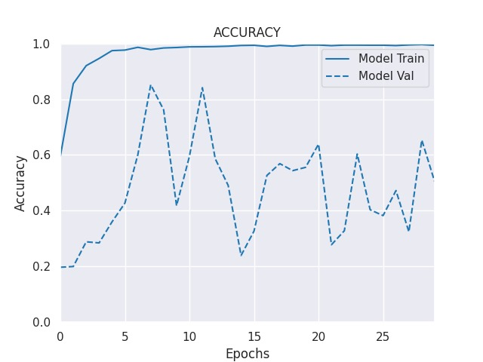
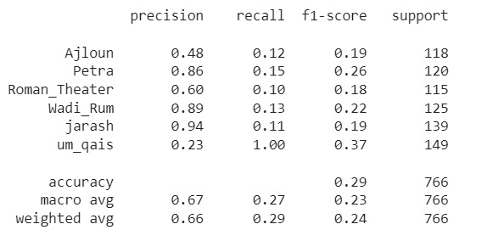
EfficientNet

Slide 22
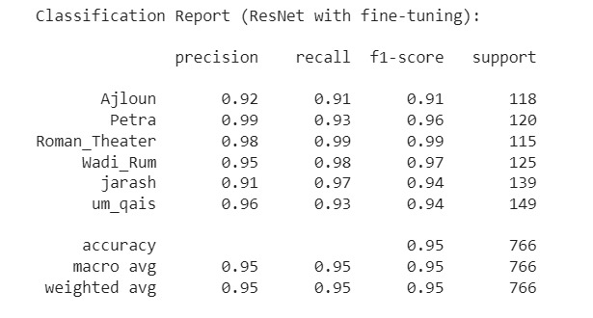
ResNet

Slide 23
02
pretrained models with augmentation
The augmentation prosess we used ImageDataGenerator with parameters:
featurewise_center=True,
featurewise_std_normalization=True,
rotation_range=20,
fill_mode='nearest',
validation_split = 0.20

Slide 24
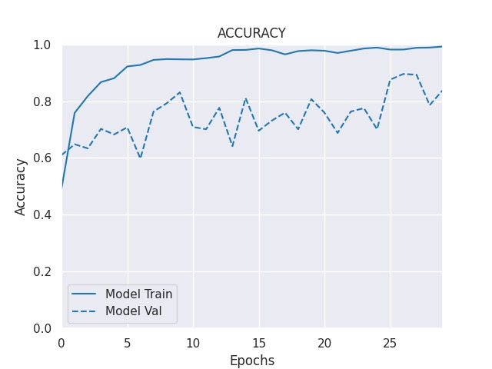
VGG16

Slide 25
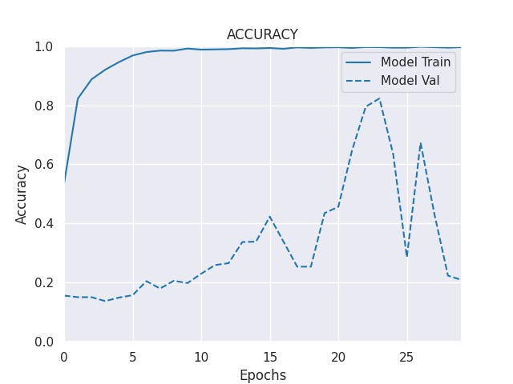
EfficientNet

Slide 26
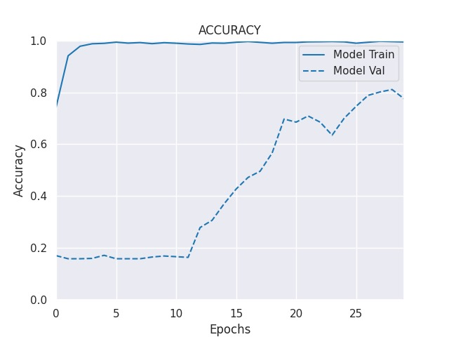
ResNet

Slide 27
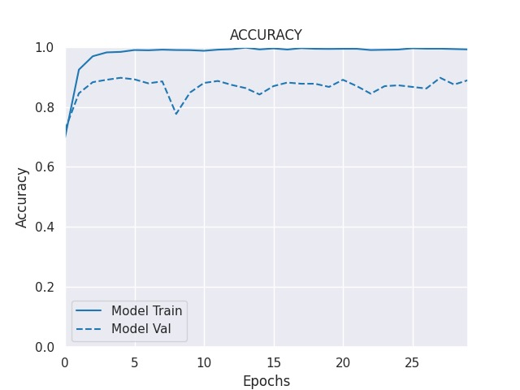
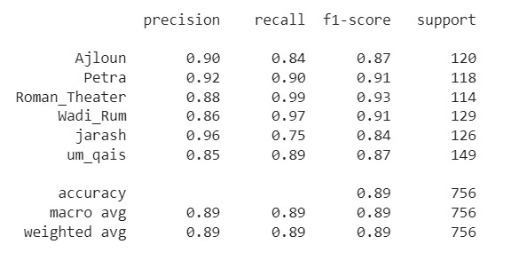
InceptionV3

Slide 28
05
Result

Slide 29
Model | Accuracy | Precision | recall | F1 score
VGG16 | 91% | 89% | 76% | 82%
InceptionV3 | 59% | 94% | 87% | 90%
ResNet | 95% | 92% | 91% | 91%
EfficientNet | 29% | 48% | 12% | 19%
Models result

Slide 30
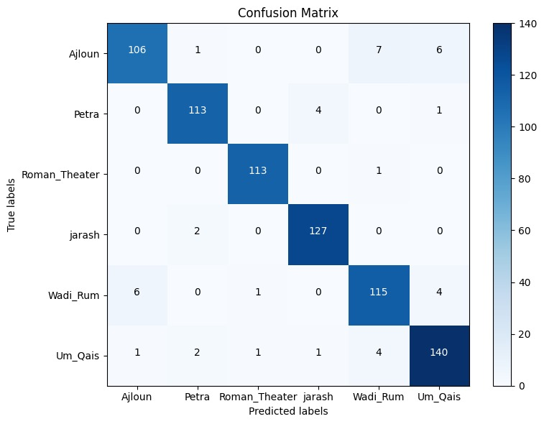
InceptionV3
Without augmentation

Slide 31
06
Conclusion and future work

Slide 32


Conclusion
In this presentation we have worked to show two method to identification and classification of certain archaeological sites :
1- using CNN model
2- using several pre-trained models
Data contain 6 classes: Petra, Um Qais, Wadi Rum, Ajloun Castle, Roman Amphitheater, Jerash
CNN model contain Conv2D layers, MaxPooling, BatchNormalization and so on..
Using 4 pre-trained models: VGG16, ResNet, InceptionV3, EfficientNet
Trying models with augmentation & without make augmentation
The best result that came out of us through experimentation was InceptionV3 without augmentation

Slide 33
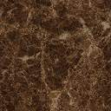
future work
Increase the number of image to train the model
enhance the demo web page by add more function
Add more archeological sites

Slide 34
referance
https://github.com/hasanoqool

Slide 35
07
Demo

Slide 36

Scan Me

Slide 37


